Slide 1
EDA Assignment
Deepa Mudiganti
UpGrad-IIIt-b
Data Science Program-December 2023

Slide 2
Introduction
“I knew that if I failed I wouldn’t regret that, but I knew the one thing I might regret is not trying.” — Jeff Bezos.
As rightly said by one of the richest men in the world. If we don’t take and deal with Risks it is impossible to lead a successful life. However it has to be a calculated risk and one should be aware of the profits and losses factors. Analyzing the historical data and drawing reference from it to make a decision for future is know as predictive analysis in business world today. It is one of the key factors to run a business successfully.
Banking and financial sectors are more prone to risk factors. Hence it becomes more crucial for these institutions to identify, measure and mange risks.

Slide 3
application_data Vs previous_application
Let us read the data and draw inferences from it to help this sector analyse risk and make a business decision. The analysis of data will help the sector to do a predictive analysis to design the product accordingly for future.

Slide 4
Conclusion
Application_Data
Previous_Application
Shape of the data: (307511,122)
There are 81 columns with null values.
There are around 41 columns with more than 50% missing values which can be imputed.
There are around 5 columns with less than 15% missing values that can be filled using different resources.
Shape of the data: (1670214,37)
There are 31 columns with null values.
There are around 4 columns with more than 50% missing values which can be imputed.
There are no columns with less than 15% missing values.

Slide 5
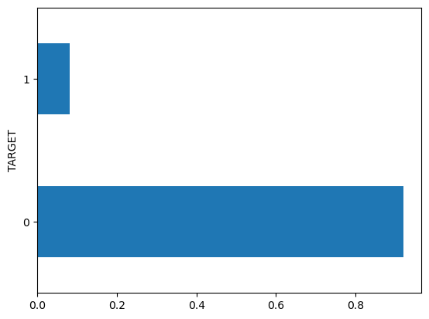
Defaulters VS Non-defaulter for the data
Application_Data

Slide 6
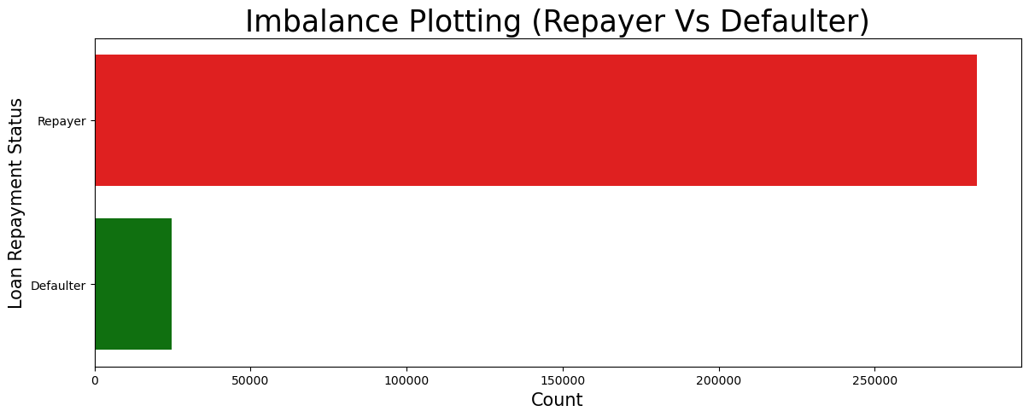
Defaulters Vs Non Defaulters imbalance

Slide 7
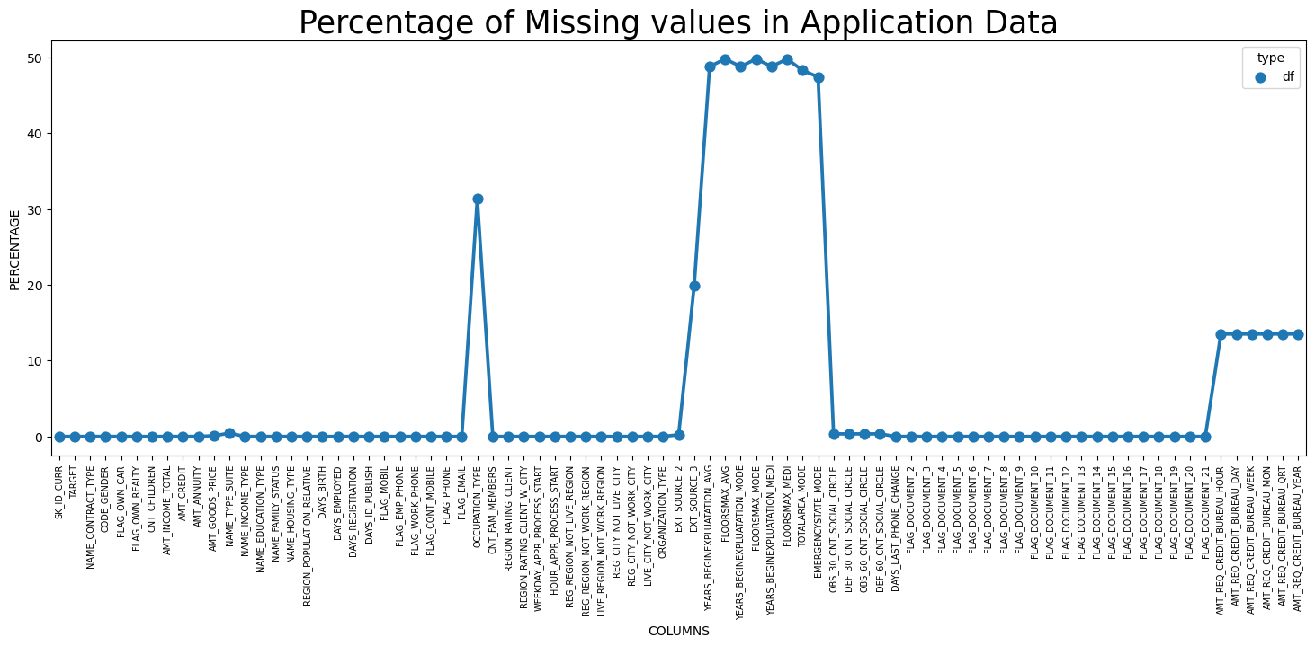
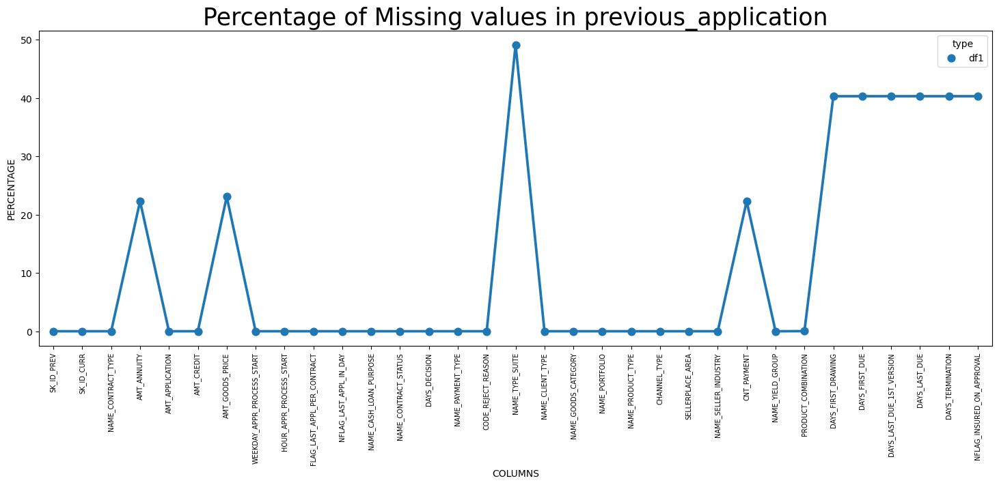
Percentage of missing values
Application_data
Previous_application

Slide 8
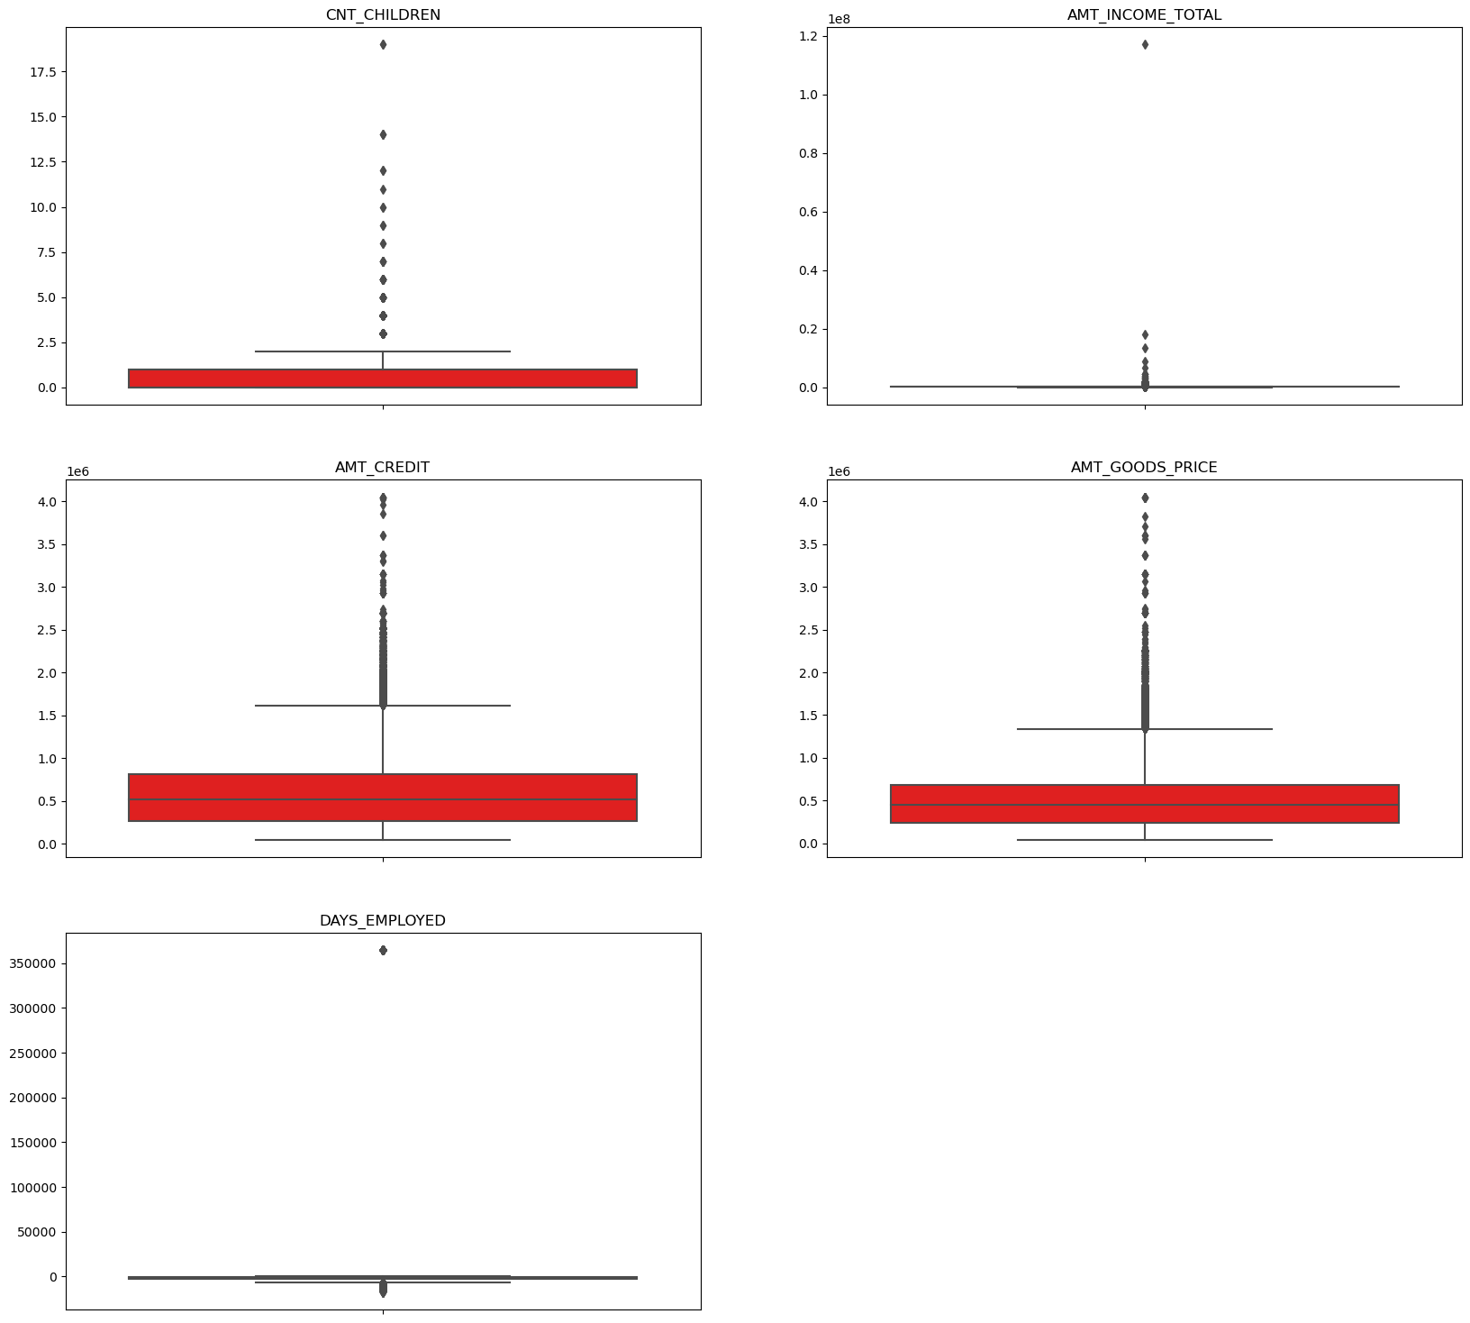
Outlier columns
Application_Data
CNT_CHILDREN,AMT_INCOME_TOTAL,DAYS_EMPLOYED have some outliers
AMT_INCOME_TOTAL has a huge outlier which can be dropped
DAYS_EMPLOYEED also has an outlier which is unrealistic. There is a possibility that it is an incorrect entry.

Slide 9
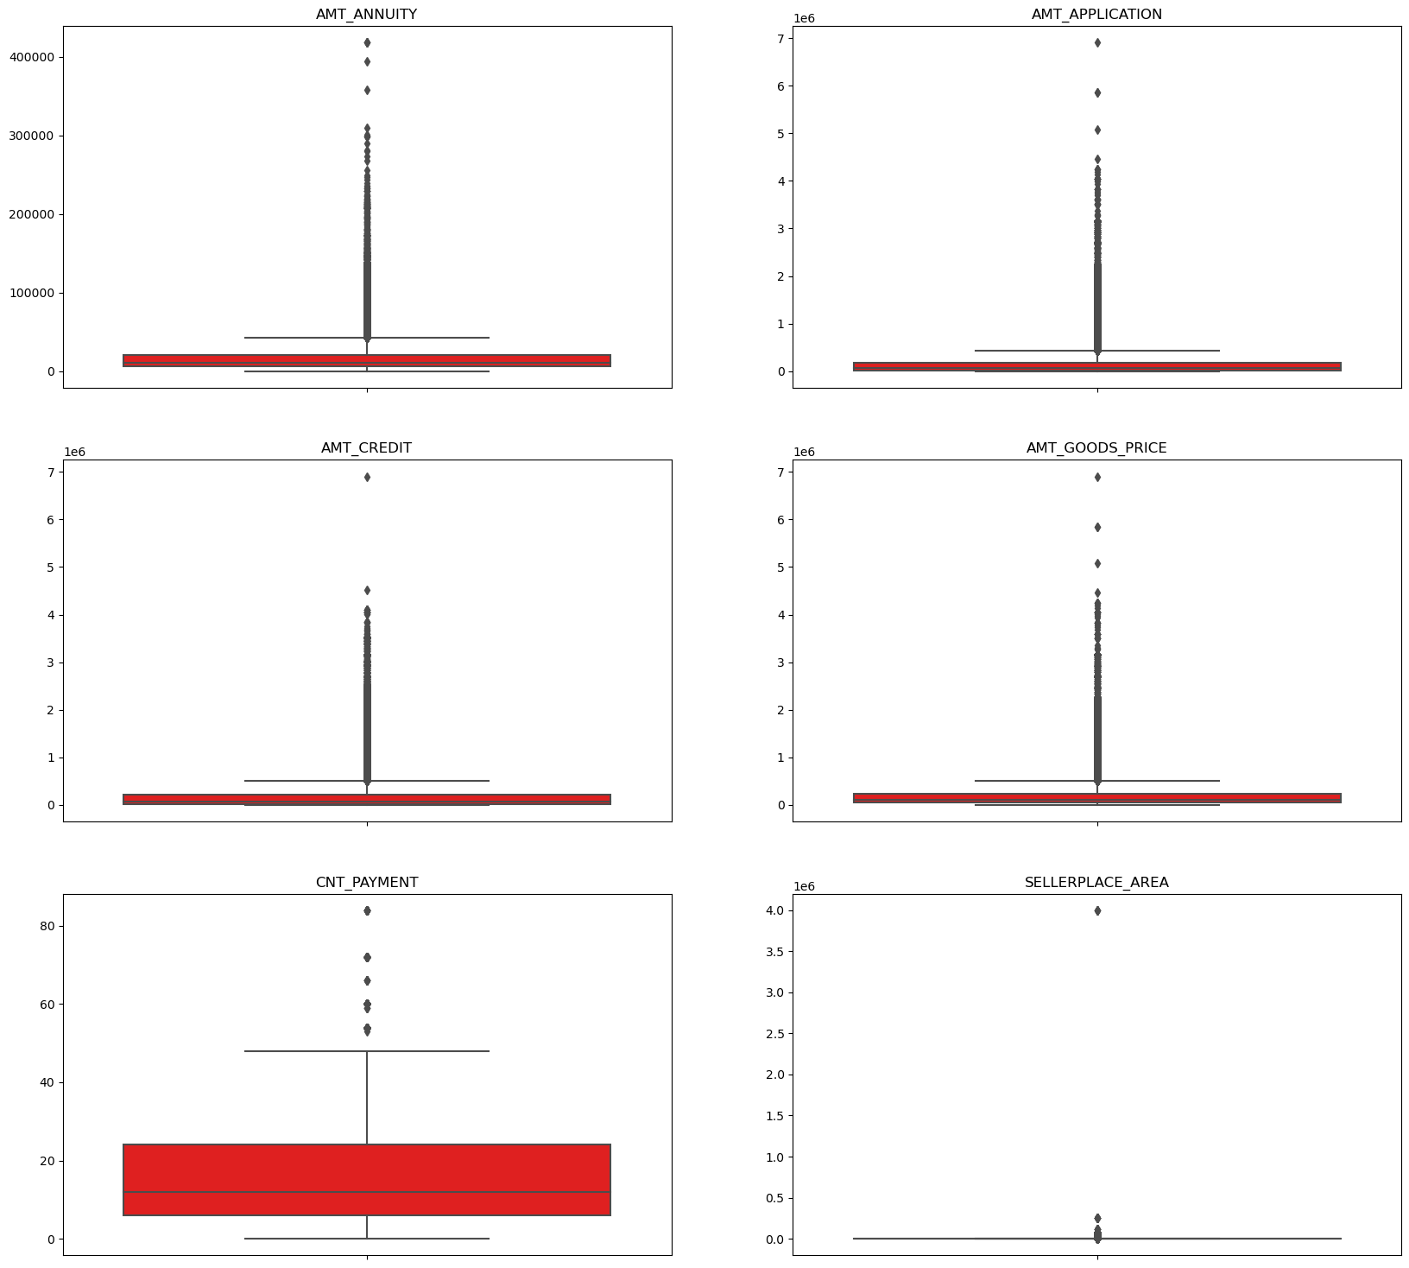
Outlier columns
Previous_Application
Except column CNT_Payment all the columns have outliers.
We can analyze the data thoroughly and see if these are really outliers or just higher values and if required impute the rows accordingly.

Slide 10
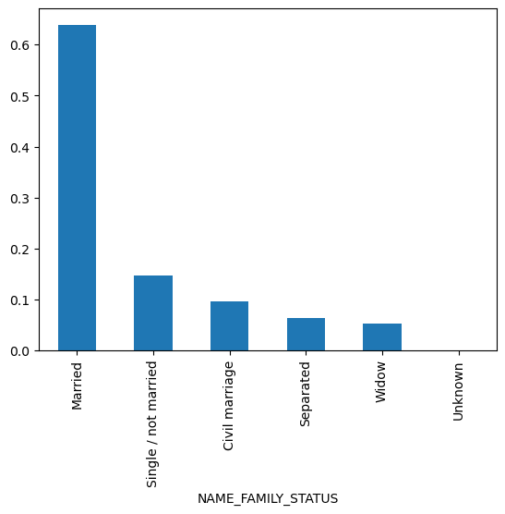
Univariate analysis – application_data
NAME_FAMILY_STATUS
We have more customers who are married
Next is single/not married who applied for a loan

Slide 11
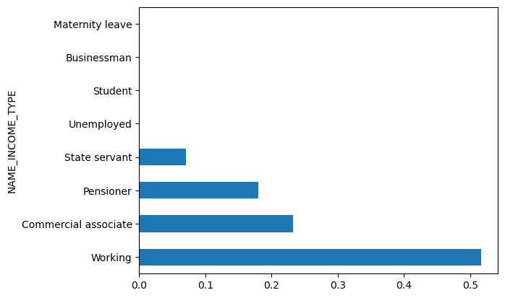
Univariate analysis – application_data
NAME_INCOME_TYPE
we see that we have more number of working people applying fro loan followed by commercial associate and pensioner

Slide 12
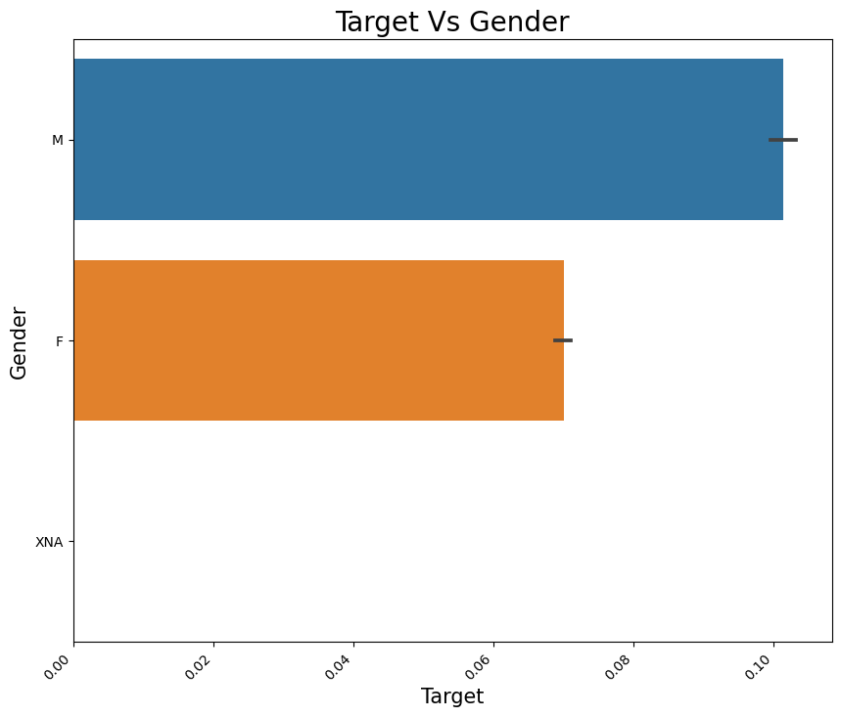
bivariate analysis – application_data Target Vs Gender
we see that more Defaulters are Males compared to females.
XNA is null value again which we need to find and fill the data using fillna()

Slide 13
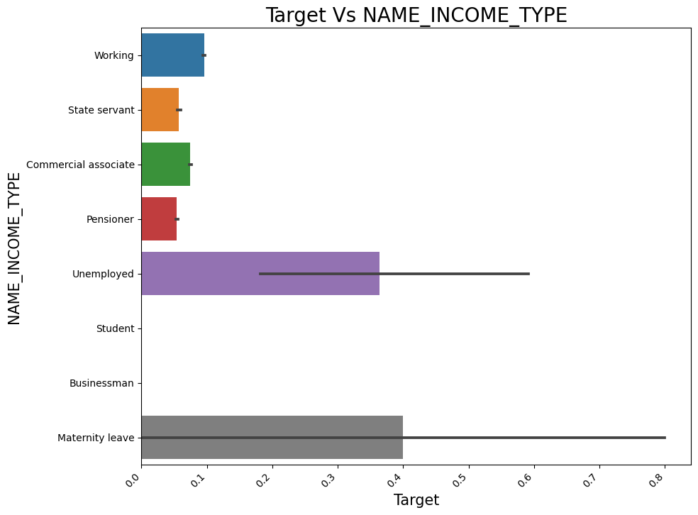
bivariate analysis – application_data Target Vs Name_income_type
We see that people on maternity leave and unemployed tends to default more.

Slide 14
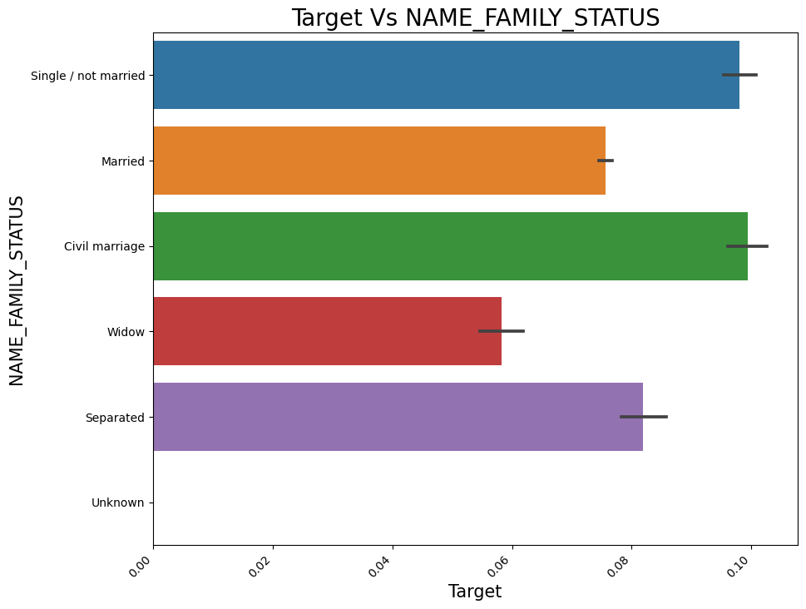
bivariate analysis – application_data Target Vs NAME_FAMILY_STATUS
We see that people with status as single/not married and civil marriage have more number of defaulters followed by separated and married.

Slide 15
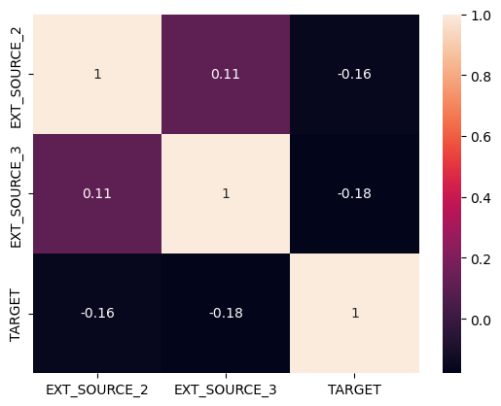
Multivariate analysis Ext_sources Vs Target column

Slide 16
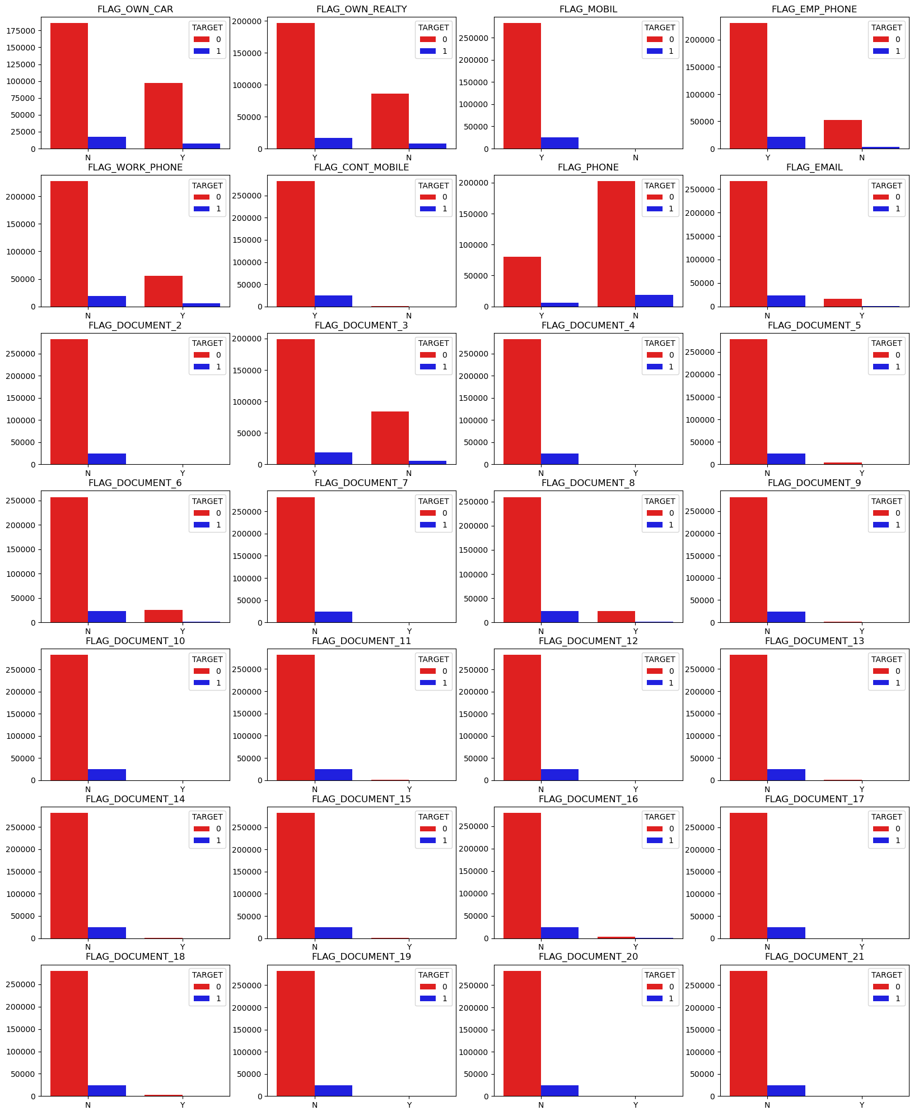
Multivariate analysis Flag_columns Vs Target column

Slide 17

Merged both the data sets for further analysis Data Imbalance

Slide 18
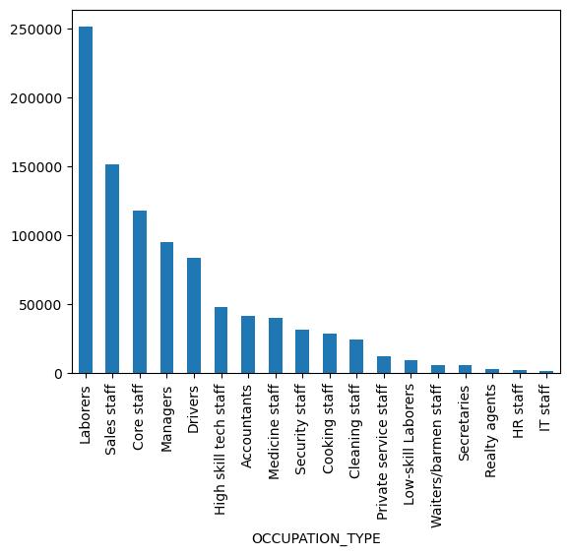
Merged both the data sets for further analysis univariate analysis – occupation_type

Slide 19
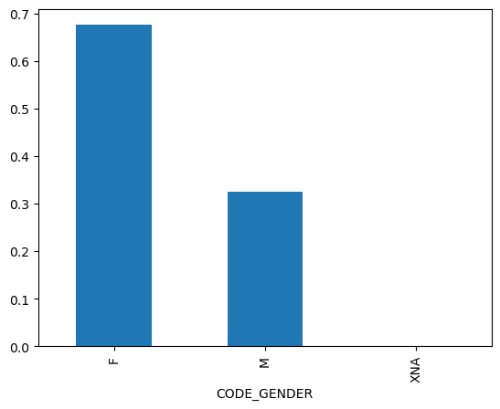
Merged both the data sets for further analysis univariate analysis – Code_gender

Slide 20
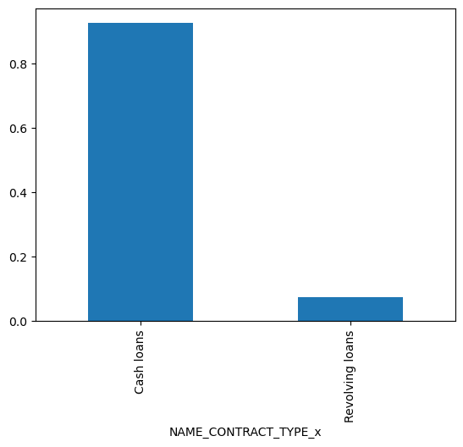
Merged both the data sets for further analysis univariate analysis – NAME_CONTRACT_TYPE_x

Slide 21
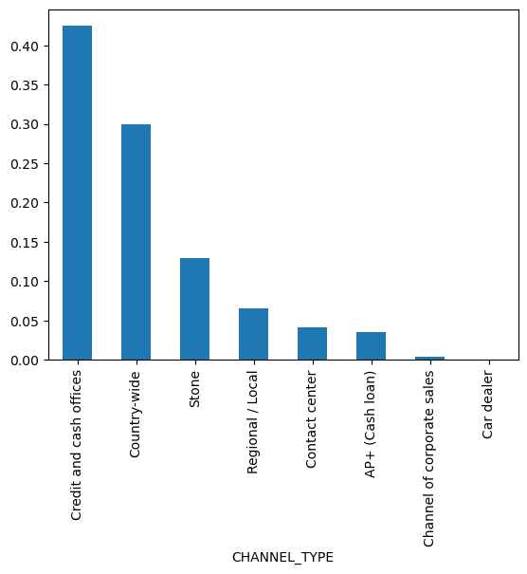
Merged both the data sets for further analysis univariate analysis – CHANNEL_TYPE

Slide 22
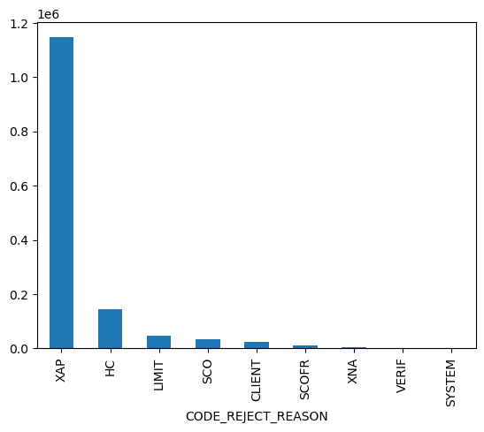
Merged both the data sets for further analysis univariate analysis – CODE_REJECT_REASON

Slide 23
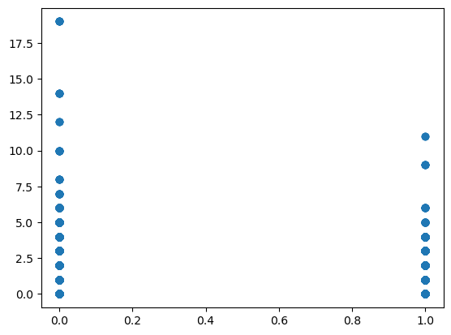
Merged both the data sets for further analysis bivariate analysis – target vs cnt_children

Slide 24
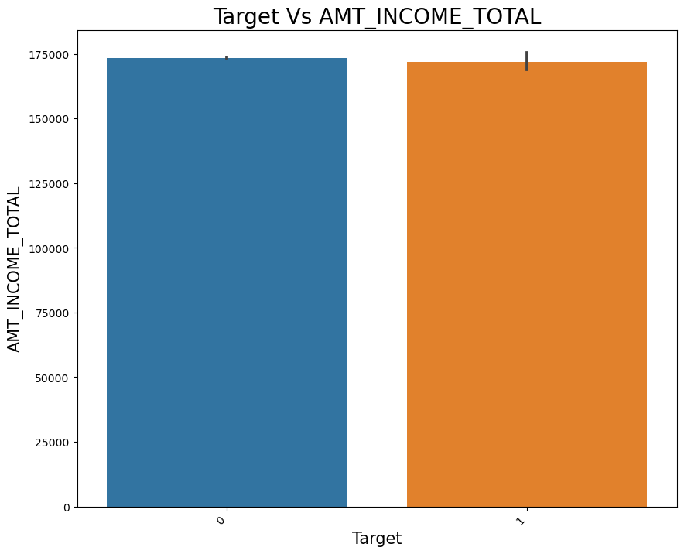
Merged both the data sets for further analysis bivariate analysis – target vs amt_total_income

Slide 25
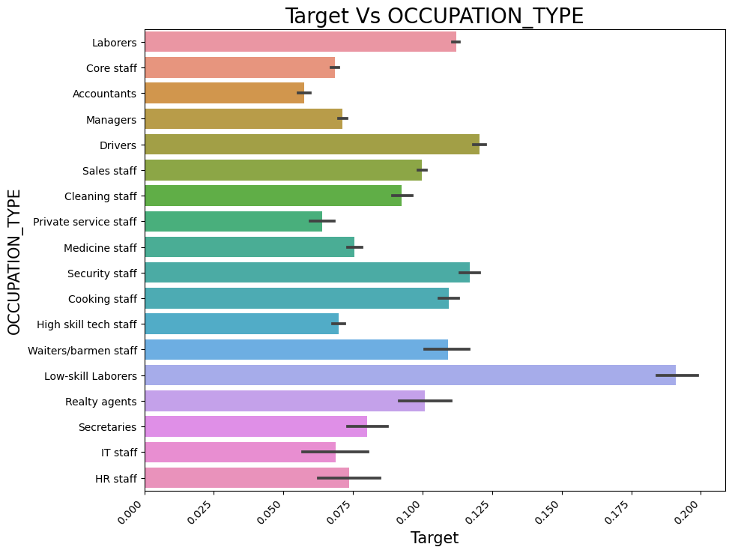
Merged both the data sets for further analysis bivariate analysis – target vs OCCUPATION_TYPE

Slide 26
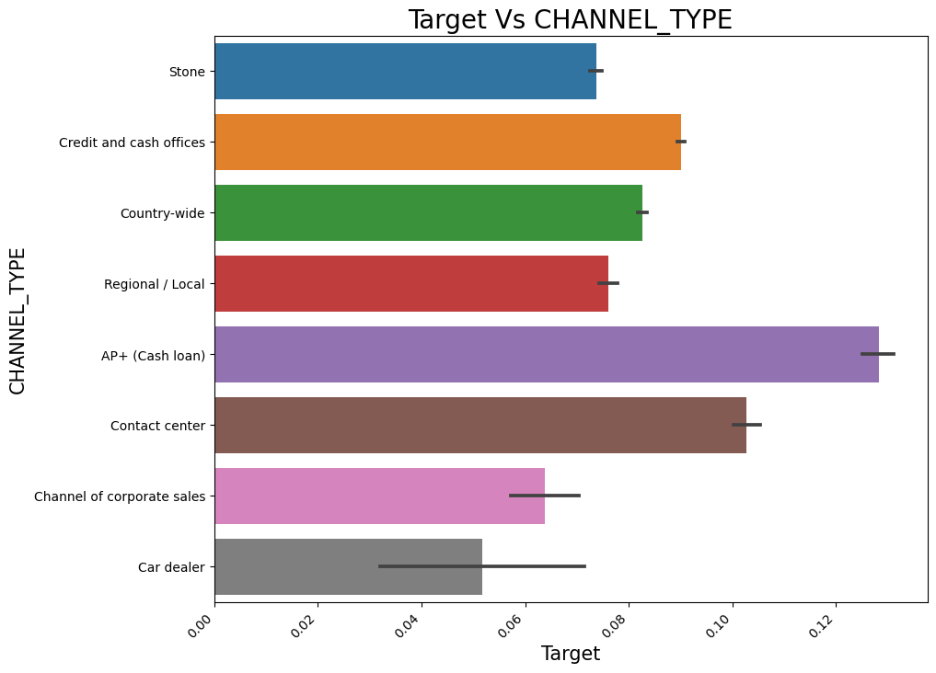
Merged both the data sets for further analysis bivariate analysis – target vs CHANNEL_TYPE

Slide 27
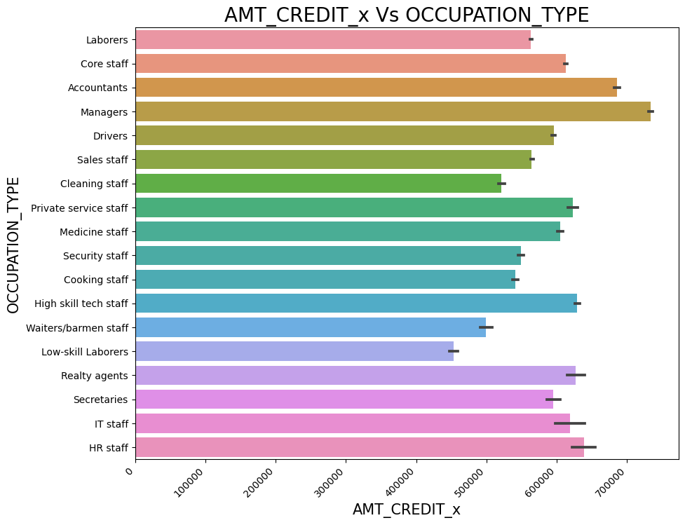
Merged both the data sets for further analysis bivariate analysis – AMT_CREDIT_x vs OCCUPATION_TYPE

Slide 28
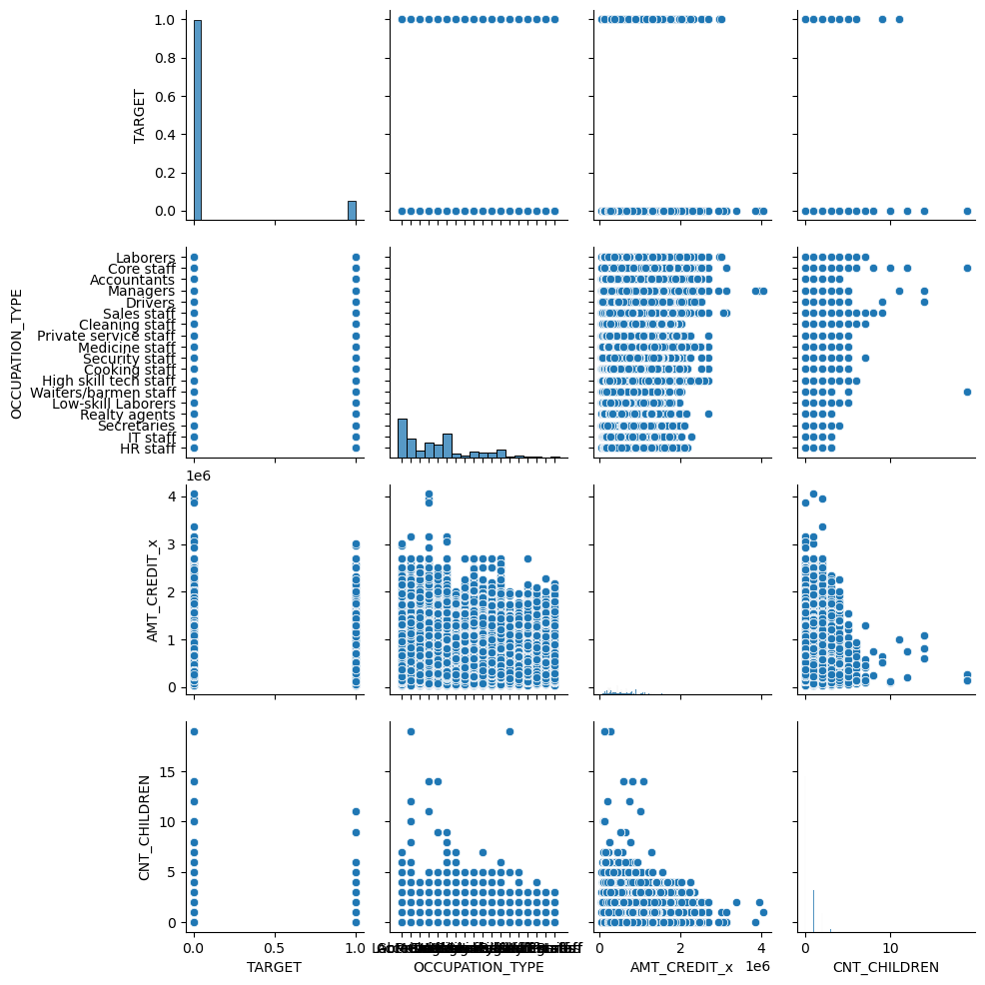
Merged both the data sets for further analysis Multivariate analysis – target vs OCCUPATION_TYPE vs AGE

Slide 29
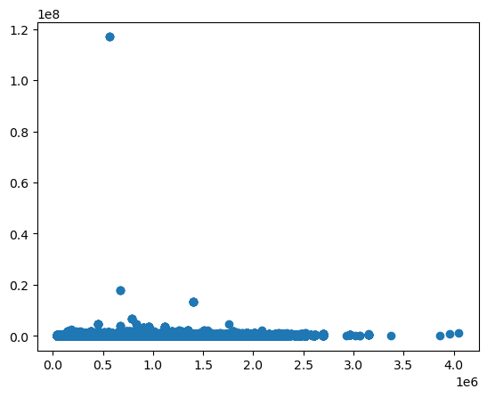
Merged both the data sets for further analysis bivariate analysis – AMT_CREDIT_x vs amt_total_income

Slide 30
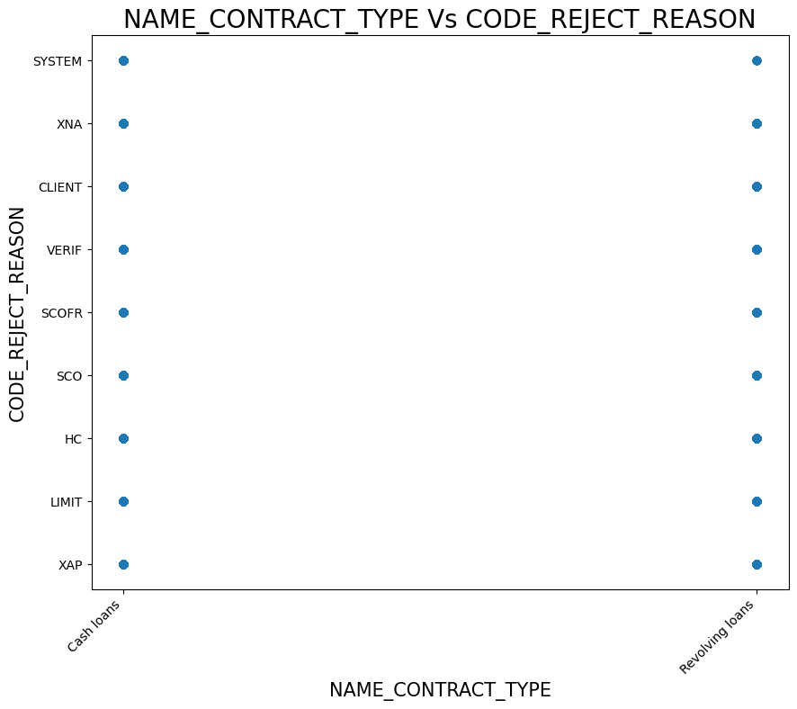
Merged both the data sets for further analysis bivariate analysis – NAME_CONTRACT_TYPE_x vs CODE_REJECT_REASON

Slide 31
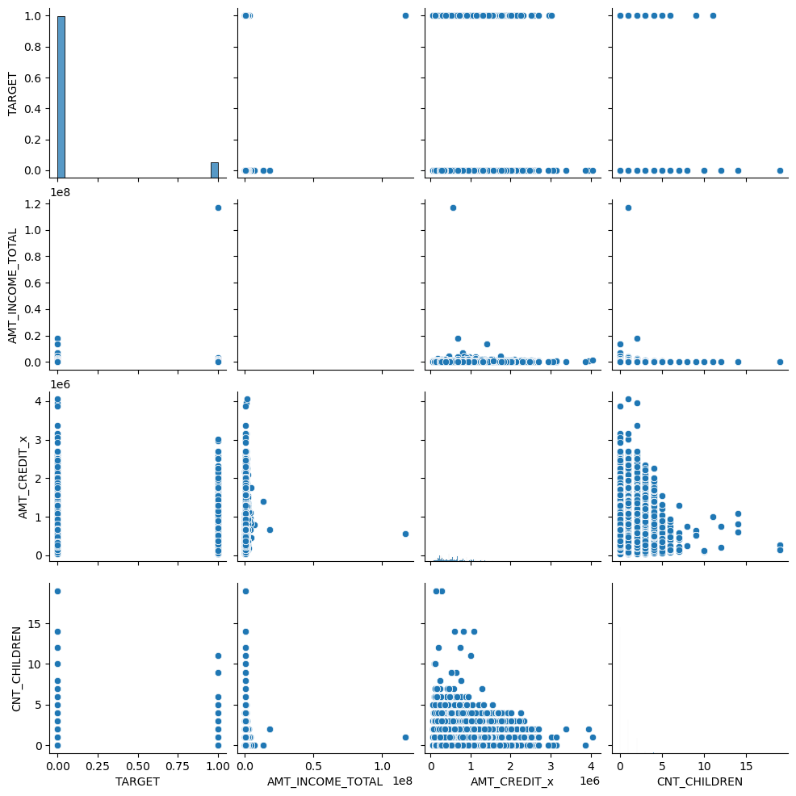
Merged both the data sets for further analysis multivariate analysis – TARGET, AMT_INCOME_TOTAL, AMT_CREDIT_x, CNT_CHILDREN

Slide 32
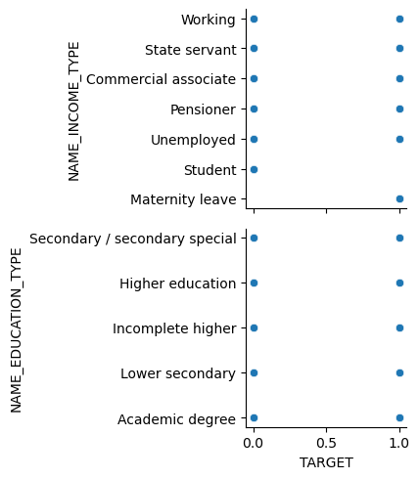
Merged both the data for further analysis multivariate analysis – TARGET, name_INCOME_Type, name_education_type

Slide 33
Summary
After analysing the data following are the points to keep in mind for a business decision:
The Defaulter percentage is very low comparatively
People who opted for cash loan have more number of defaulters.
We have more male member have defaulters
we see that we have more number of working people applying for loan followed by commercial associate and pensioner
we see that we have more number of working people applying for loan followed by commercial associate and pensioner
We see that more number of females have applied for a loan
People with more than 5 children tend to default more

Slide 34
Summary….
Most of the customers are acquired from Credit card and cash offices followed by country-wide. These areas need to be focused more.
We see the amount of loan applied for is highest for managers. Since they are also re-payers they should be the priority to approve loans

Slide 35
Thank You

